Slide 1
Chapter 18 Neural Radiance Field
Prof. Lin ZHANG
School of Computer Science and Technology
Tongji University

Slide 2
Outline
Rendering based on Radiance field
Continuous form
Discrete form
Neural Radiance Field (NeRF) and Its Training

Slide 3
Rendering based on radiance field—Continuous form
Radiance field based rendering
This rendering method treats the physical space containing the scene as a radiance field: each point in the space possesses two attributes, opacity and view-dependent color
The goal of the rendering process is to generate an image of the scene from the perspective of a virtual camera
The viewpoint of the virtual camera is defined by its pose in the world coordinate system. The essence of the rendering operation is to determine the color of each point on the imaging plane of the virtual camera.

Slide 4



Rendering based on radiance field—Continuous form
三维场景辐射场
视角B
视角A
视角B下的渲染照片
视角A下的渲染照片

Slide 5
Rendering based on radiance field—Continuous form
volume
p
t_{f}
d
t_{n}
o
The essential question is: for a given pixel position p on the image, how to determine its color?

Slide 6
Rendering based on radiance field—Continuous form
p‘s color can be calculated as,
(1)
σ(x) represents the opacity at the spatial location x
r(t) = o+td (t∈[t_{n}, t_{f}]) is one point along the ray , parameterized by t; o is the camera center; d is the unit vector of the ray
c(r(t), d) is the color of the spatial position r(t) when viewed along the direction d
T(t) is the accumulated opacity along the ray from the point r(t_{n}) to r(t),

Slide 7
Rendering based on radiance field—Discrete form
With Eq. (1), to compute the color u(p), we need to compute an integral along the ray , which is not easy to be implemented
Need to find a way to convert the integral to summation
The discrete form of the radiance field based rendering

Slide 8
Rendering based on radiance field—Discrete form
Divide the range [t_{n}, t_{f}] to N sub-ranges,
……
区间i-1
区间i
区间i+1
……
t_{n}
t_{i-1}
t_{i}
t_{i+1}
t_{f}
The ith sub-range is
In sub-range i, randomly sample one point t_{i} whose value conforms to a uniform distribution,
Then, Eq. (1) can be approximated as,
(2)

Slide 9
Rendering based on radiance field—Discrete form
By considering the opacity and the color in the sub-range [t_{i}, t_{i+1}] as constants,
We can have,
(3)
(4)

Slide 10
Rendering based on radiance field—Discrete form
We can have,
(5)
Discrete the computation of T_{i},
(6)
Eq. (5) and Eq. (6) together give the discrete form of the continuous rendering model described by Eq. (1)

Slide 11
Outline
Rendering based on Radiance field
Continuous form
Discrete form
Neural Radiance Field (NeRF) and Its Training

Slide 12
NeRF and its training
Radiance field can be naturally represented as a mapping function,
where F_{Θ} is the mapping function, Θ is the parameter set of F; x is a 3D point in the radiance field while d is the viewing direction; σ is the opacity of x in the radiance field, and c=(r,g,b) is the color of x when viewed along the direction of d
For a scene to be rendered, if its associated mapping model F_{Θ} is fixed, its radiance field is fixed or in other words, its radiance field is implicitly represented by F_{Θ}
F_{Θ} can be naturally represented as a neural network

Slide 13
NeRF and its training
Theoretically, F_{Θ} maps a 6d vector (x, d) to a 4d vector (c, σ). However, such a straightforward idea cannot characterize high-frequency information well
Dimensionality-increasing encoding for the position x and the direction d
Such a process can be represented as :
In the reference implementation, for the position encoding, L=10. Thus, after such a dimensionality-increasing encoding process, the data dimension is 2×10×3+3=63. For the direction encoding, L=4. Thus, after such a dimensionality-increasing encoding process, the data dimension related to dimension is 2×4×3+3=27

Slide 14
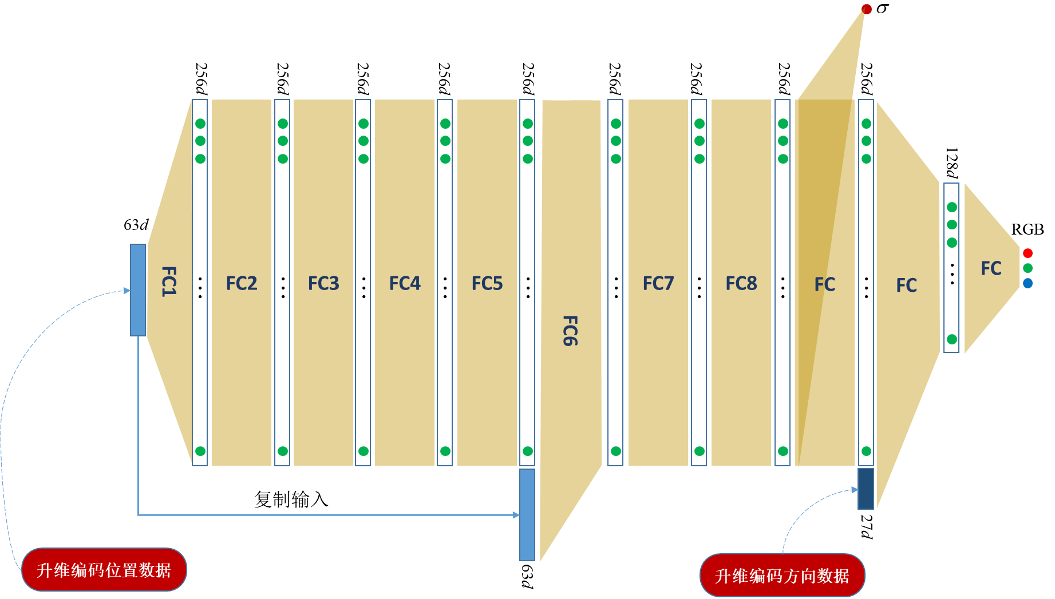
NeRF and its training
Neural network for implicitly representing the radiance field

Slide 15

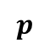
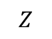
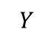
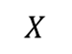

NeRF and its training
The training strategy of NeRF
$$p$$
$$X$$
$$Z$$
$$o$$
场景辐射场
$$Y$$
照片

Slide 16
NeRF and its training
The training strategy of NeRF
Collect a set of images P for the scene to be rendered; for each image in P, the associated intrinsics and extrinsics of the camera capturing it are known
The training loss for F_{Θ} is designed as,
where Ω is the pixel set from the image set P; u(p) is the ground-truth color of pixel p; is the estimated color for the pixel p with the radiance field F_{Θ}

Slide 17
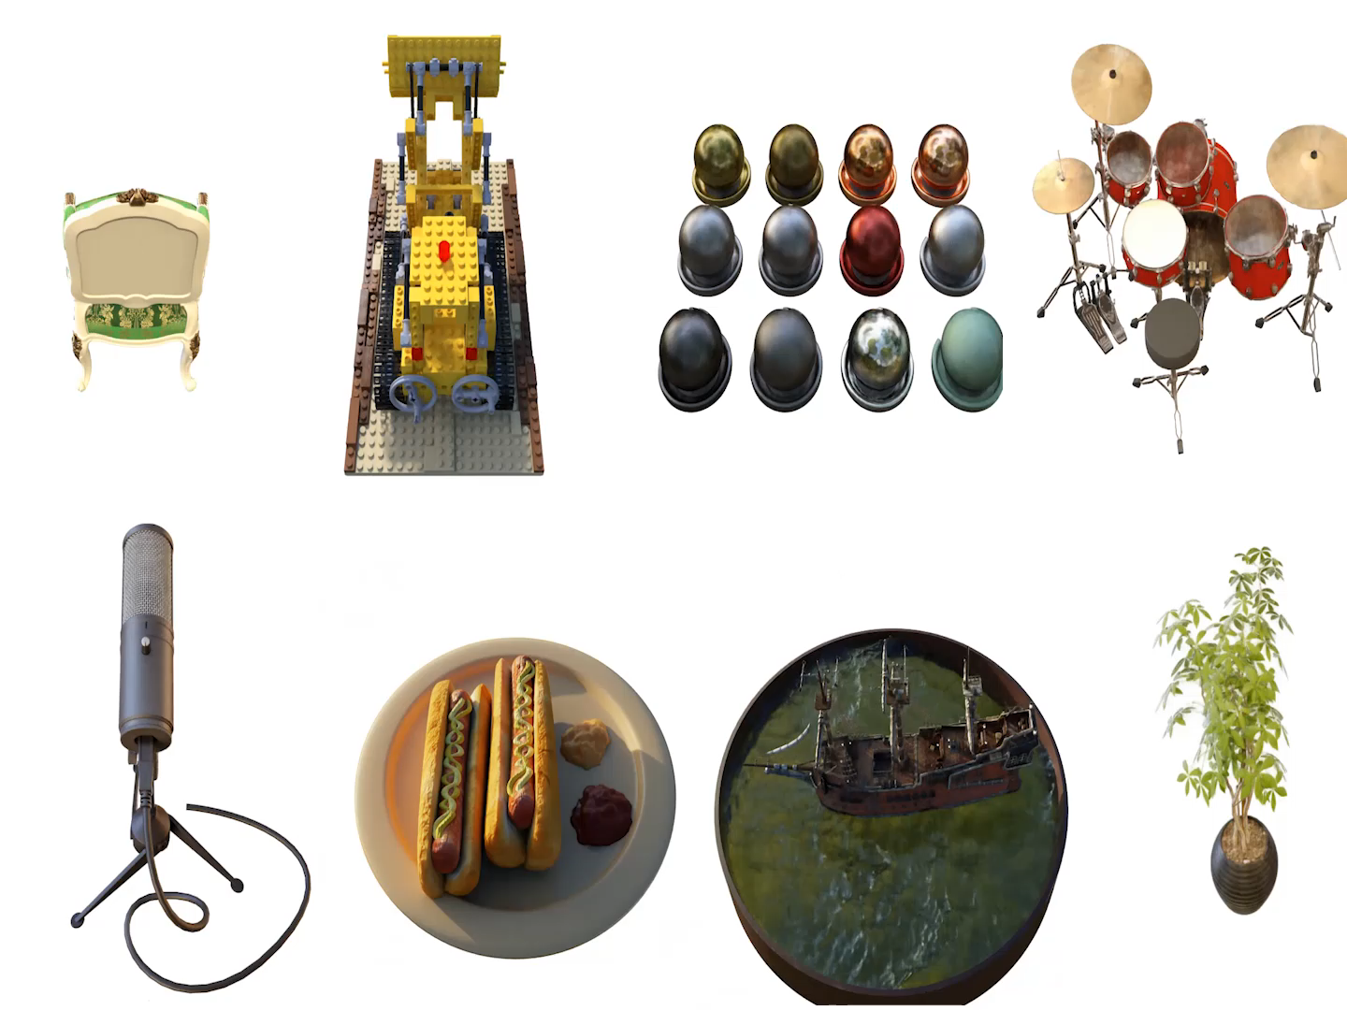

NeRF rendering results

Slide 18


